Slide 1

Side by Side & In App Extensibility
Training Deck
Deloitte Consulting LLP

Slide 2
Agenda
Topic | Sub-Topic
Introduction | What is Extensibility Motivation for Extensibility Extensibility Spectrum
In-App Extensibility | Overview of In-App Extensibility UI Adaptation Custom CDS Views Analytical Queries Custom Fields & Logic Custom Business Objects Custom Forms Flexible Workflow Lifecycle Management Extensibility
Side By Side Extensibility | Overview of Side By Side Extensibility In-App vs Side-by-side Extensibility

Slide 3
Introduction

Slide 4





What is Extensibility
The quality of being designed to allow the addition of new capabilities or functionality.
Notes:
Ice Breaker Slide

Slide 5
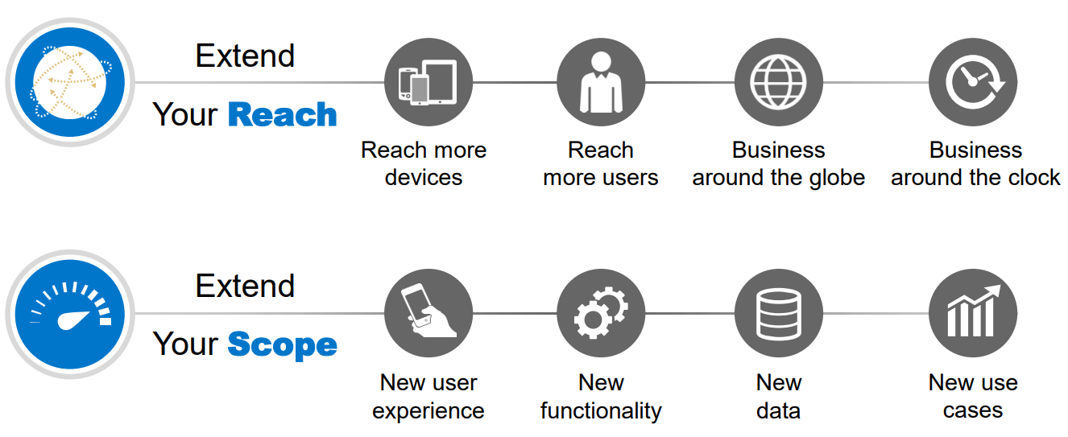
Motivation For Extensibility Concept
Classical Extensibility
Modification to SAP Code
Extensions calling SAP Code (No APIs Available)
Software Updates require major adoption in customer/partner code
De-Coupling & Lifecycle Stability
Based on Stable Extension Points
APIs are made Available
Web Based Key user tools

Slide 6
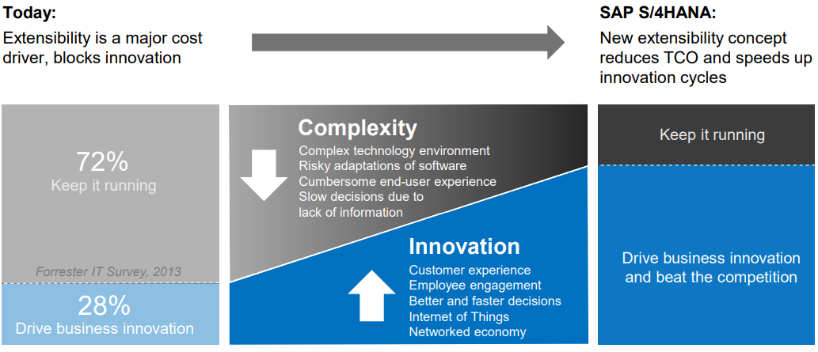
Extensibility in S/4HANA
Notes:
TCO

Slide 7
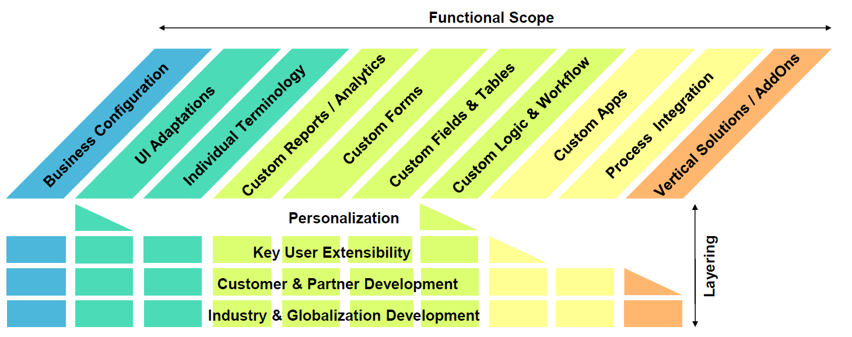
Extensibility Spectrum
Notes:
4 layers of setting extensions for.

Slide 8
In-App Extensibility

Slide 9
Overview of In-App Extensibility
Highlights
In-App Extensions allows the user to customize and adapt SAP for specific customer needs. In-App Custom Extensions are loosely coupled and hence SAP upgrade modifications do not affect the custom extensions These changes/modifications needs minimal technical skills and can expand the functional scope in short turnaround time. Extensibility Scenarios – UI Extensibility Field Extensibility Table Extensibility Logic Extensibility Report Extensibility Form Extensibility

Slide 10
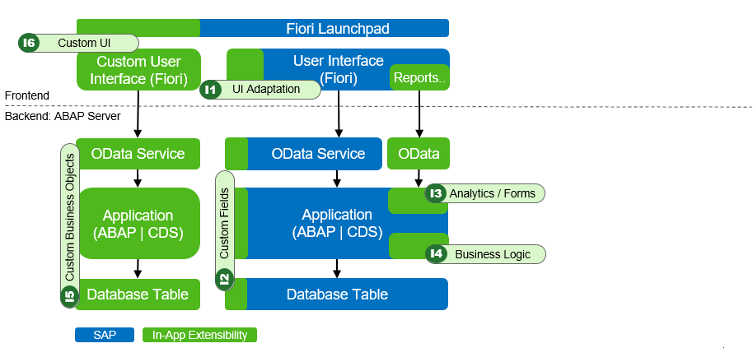
Side by Side Extensibility : Use case Diagram

Slide 11
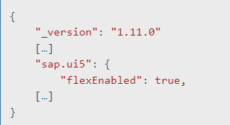
UI Adaptation(SAPUI5 Flexibility)
Introduction
UI Adaptation:
Adjustment done on UI of standard delivered apps
Can be enabled for Custom Fiori Apps
UI Adaptation Types:
Personalization - User specific ( End User)
UI Adaptation at Runtime - Global (Key User)
Personalization includes
Adding/removing filters
Adding/removing fields from the output
Changing order of fields in output
UI Adaptation at Runtime includes
Adding/removing buttons
Adding/removing fields
Renaming labels
manifest.json
Key Considerations
User must have authorization role SAP_UI_FLEX_KEY_USER assigned and Catalog /UIF/SAP_RTA_PLUGIN(Note-2584385) Done via ‘Adapt UI’ option (available in user settings ). Only Apps supporting RTA (Run Time Adaptation) can be changed.

Slide 12
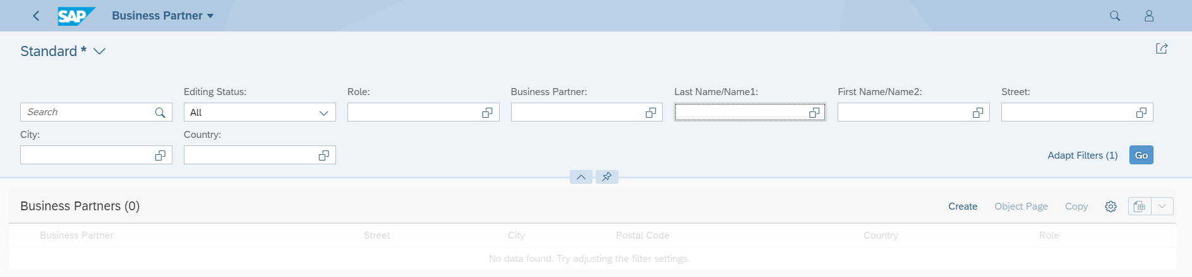
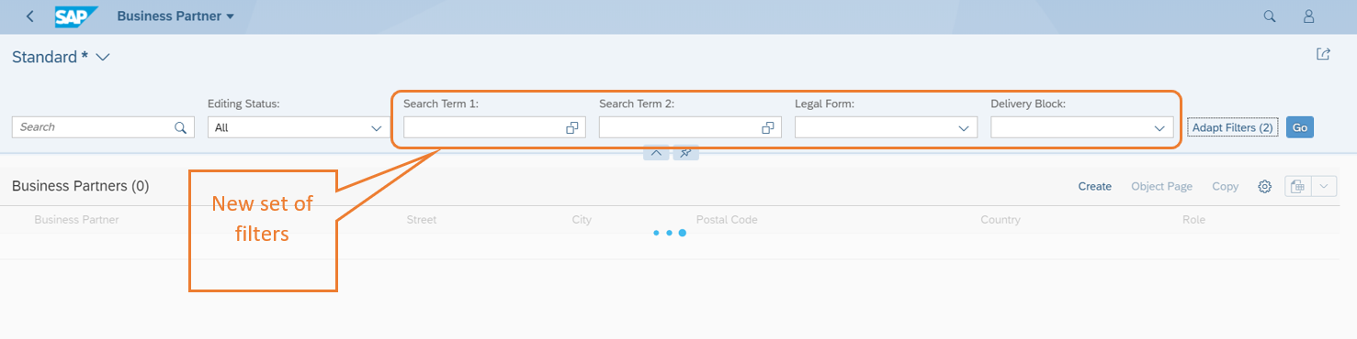
Illustration – Filter Adjustment

Slide 13
Illustration – Filter Adjustment
Steps:
Click ‘Filters’ button.
Select/Remove the filters which are needed/not needed.
Hit ‘Save’. Provide layout name and select appropriate check boxes as needed. If we select ‘Public’, system will capture the changes in TR or ask to save as local object.
Screen with new set of filter will start appearing.
App used:
No apps are needed for this functionality as this can be done at individual app level.

Slide 14
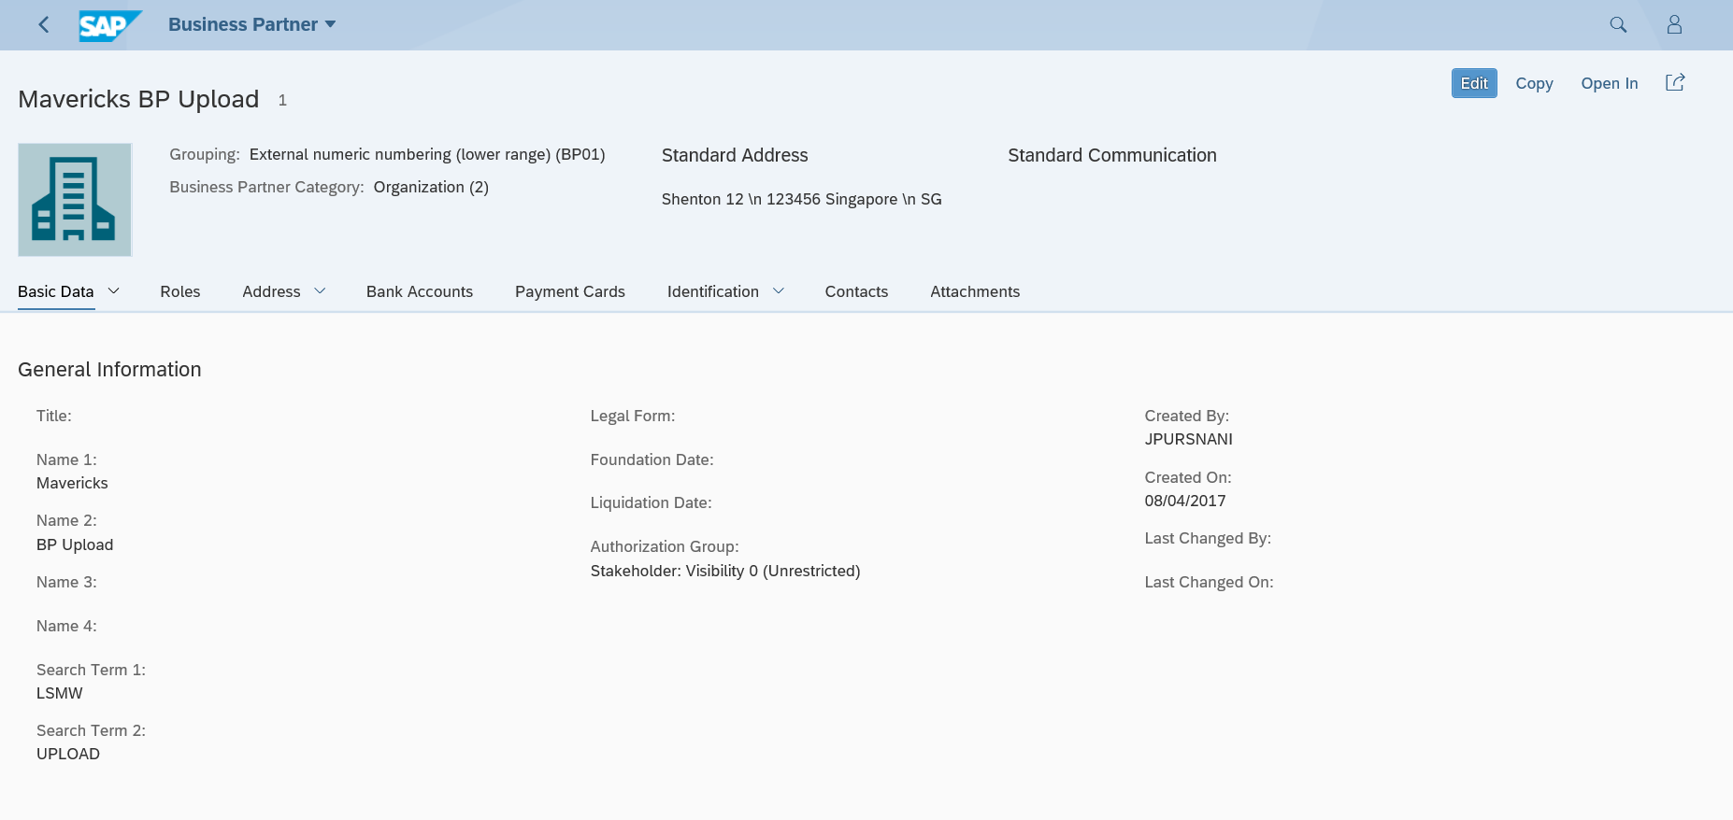
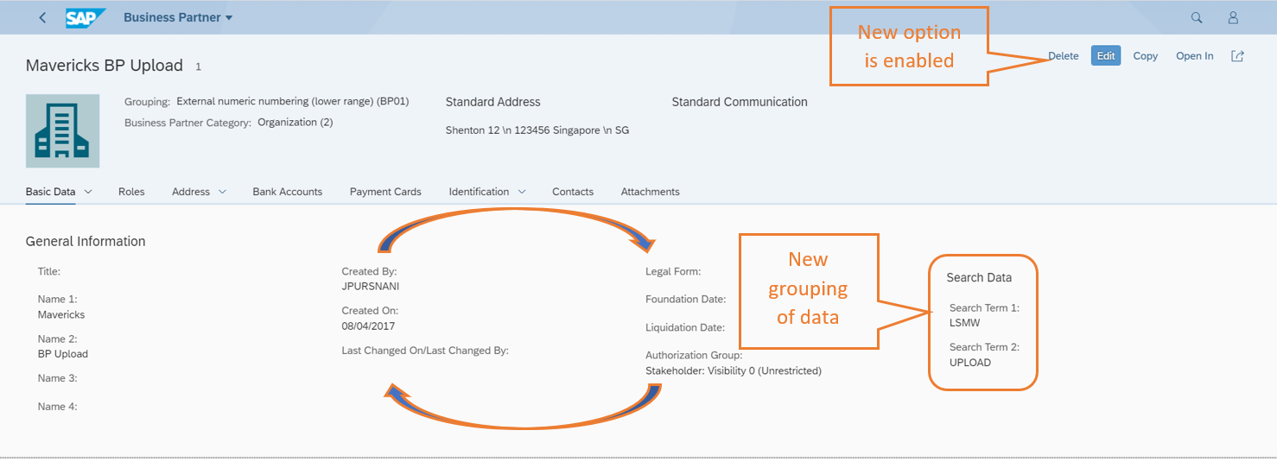
Illustration – Screen Level Adjustment

Slide 15
Illustration – Screen Level Adjustment
Steps:
Click on the button.
Select ‘Adapt UI’ option.
Perform desired operation (Create new groups, Reposition fields, Add/Remove fields, Rename fields, Add/Remove action buttons etc.).
Save and Publish.
App used:
No apps are needed for this functionality as this can be done at individual app level.
Limitations:
Only Fiori apps supported, GUI for HTML is not supported).

Slide 16
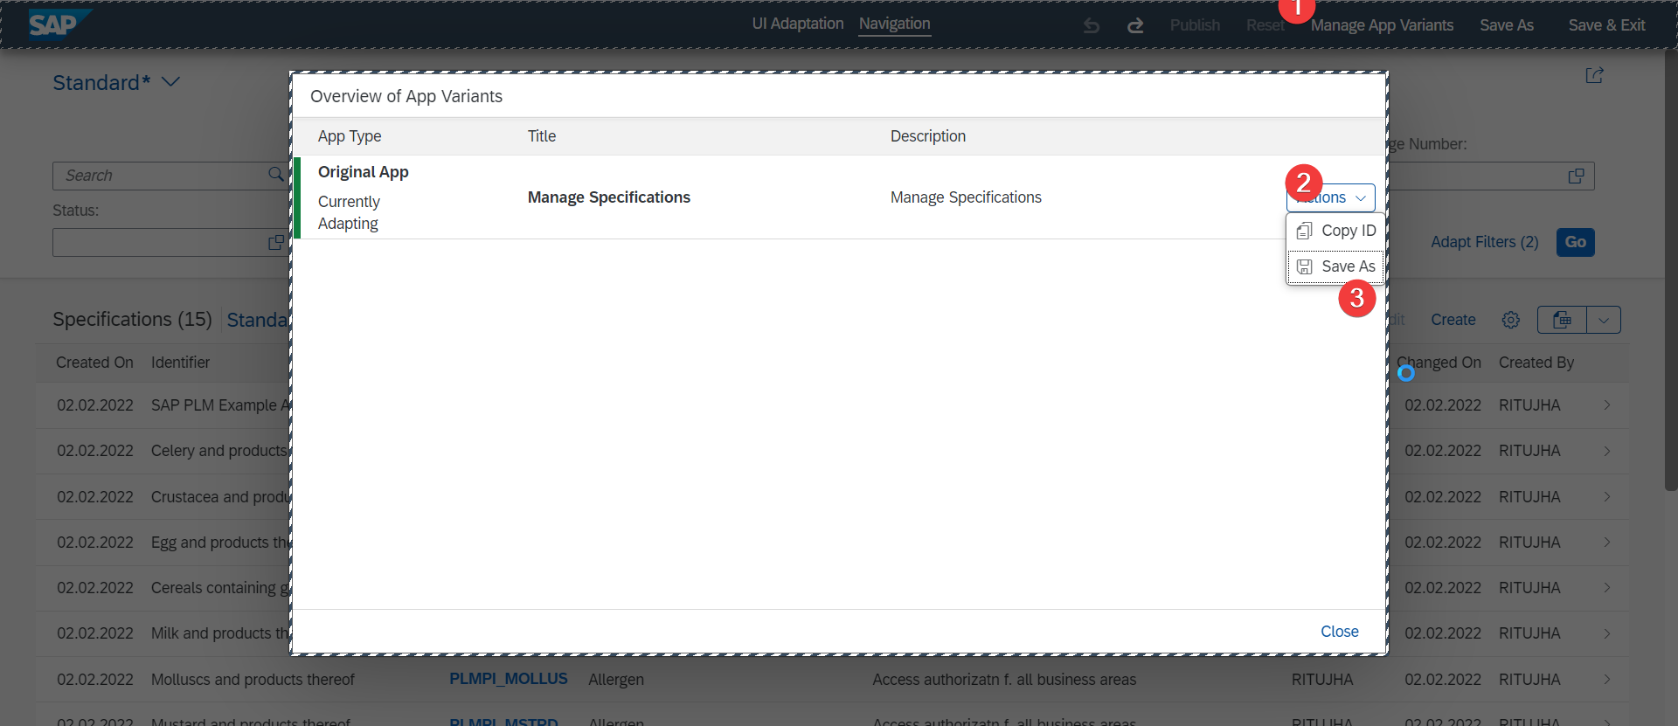
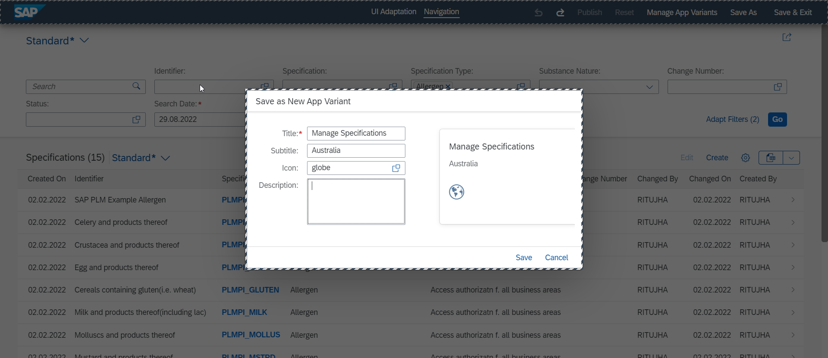
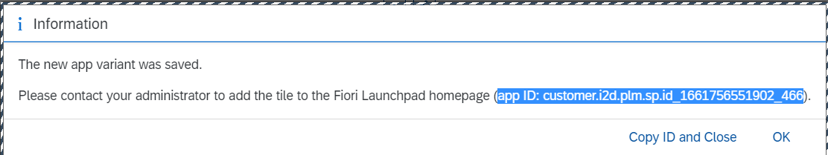
Illustration – Application Variant
Steps:
Click on the profile button.
Select ‘Adapt UI’ option & make desired changes
Click Manage app variant, Save as & give details
Note the App Id & create tile, target mapping with it.
Limitations:
Only Fiori apps supported, GUI for HTML is not supported).

Slide 17
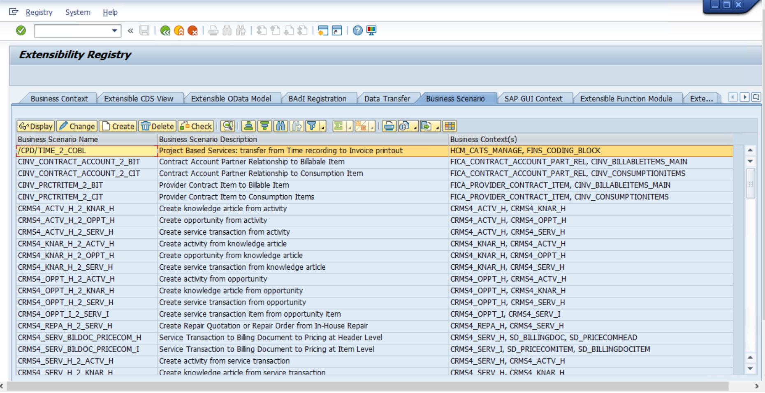
Extensibility Registry - SCFD_REGISTRY

Slide 18
Custom Fields & Logic
Introduction
Custom Fields can be created and edited, and usage includes extending the SAP table, application, CDS Views and OData Services.
In conjunction, allows easy exploration of APIs, simpler code syntax checks and quick implementation.
Custom Field and Logic serves a specified Business Context enabling a Business Process.
Ensure that Publish is needed to activate the functionality.
Key Considerations
User needs to be assigned to a business role allowing business catalog extensibility. Following usage can be enabled based on the business requirements - UIs, reports, email templates, form templates, and business scenarios.

Slide 19
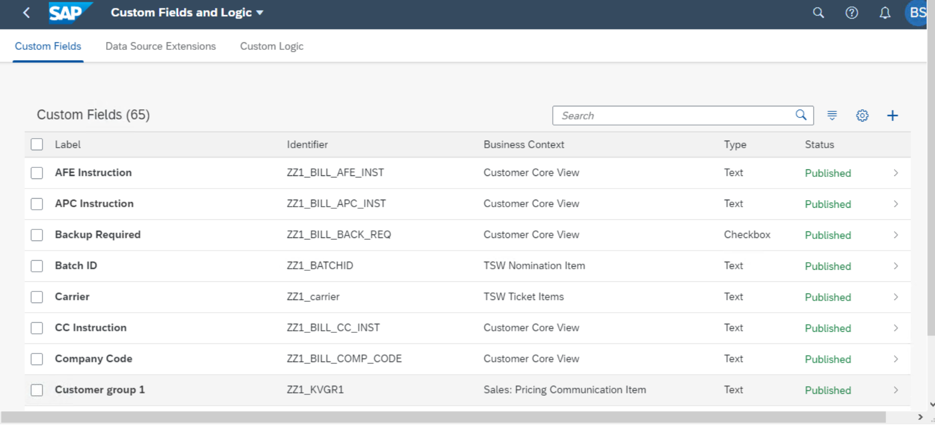

Slide 20
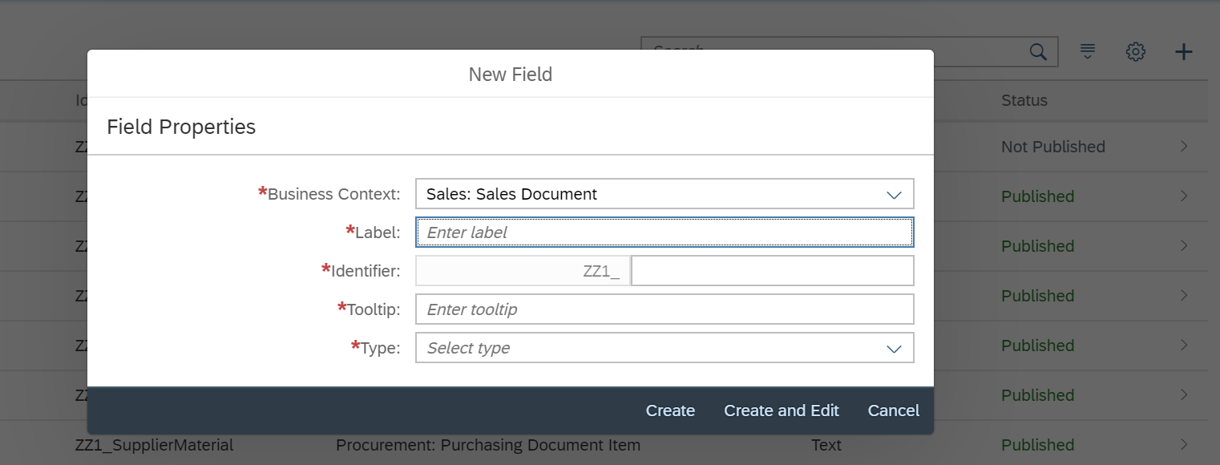
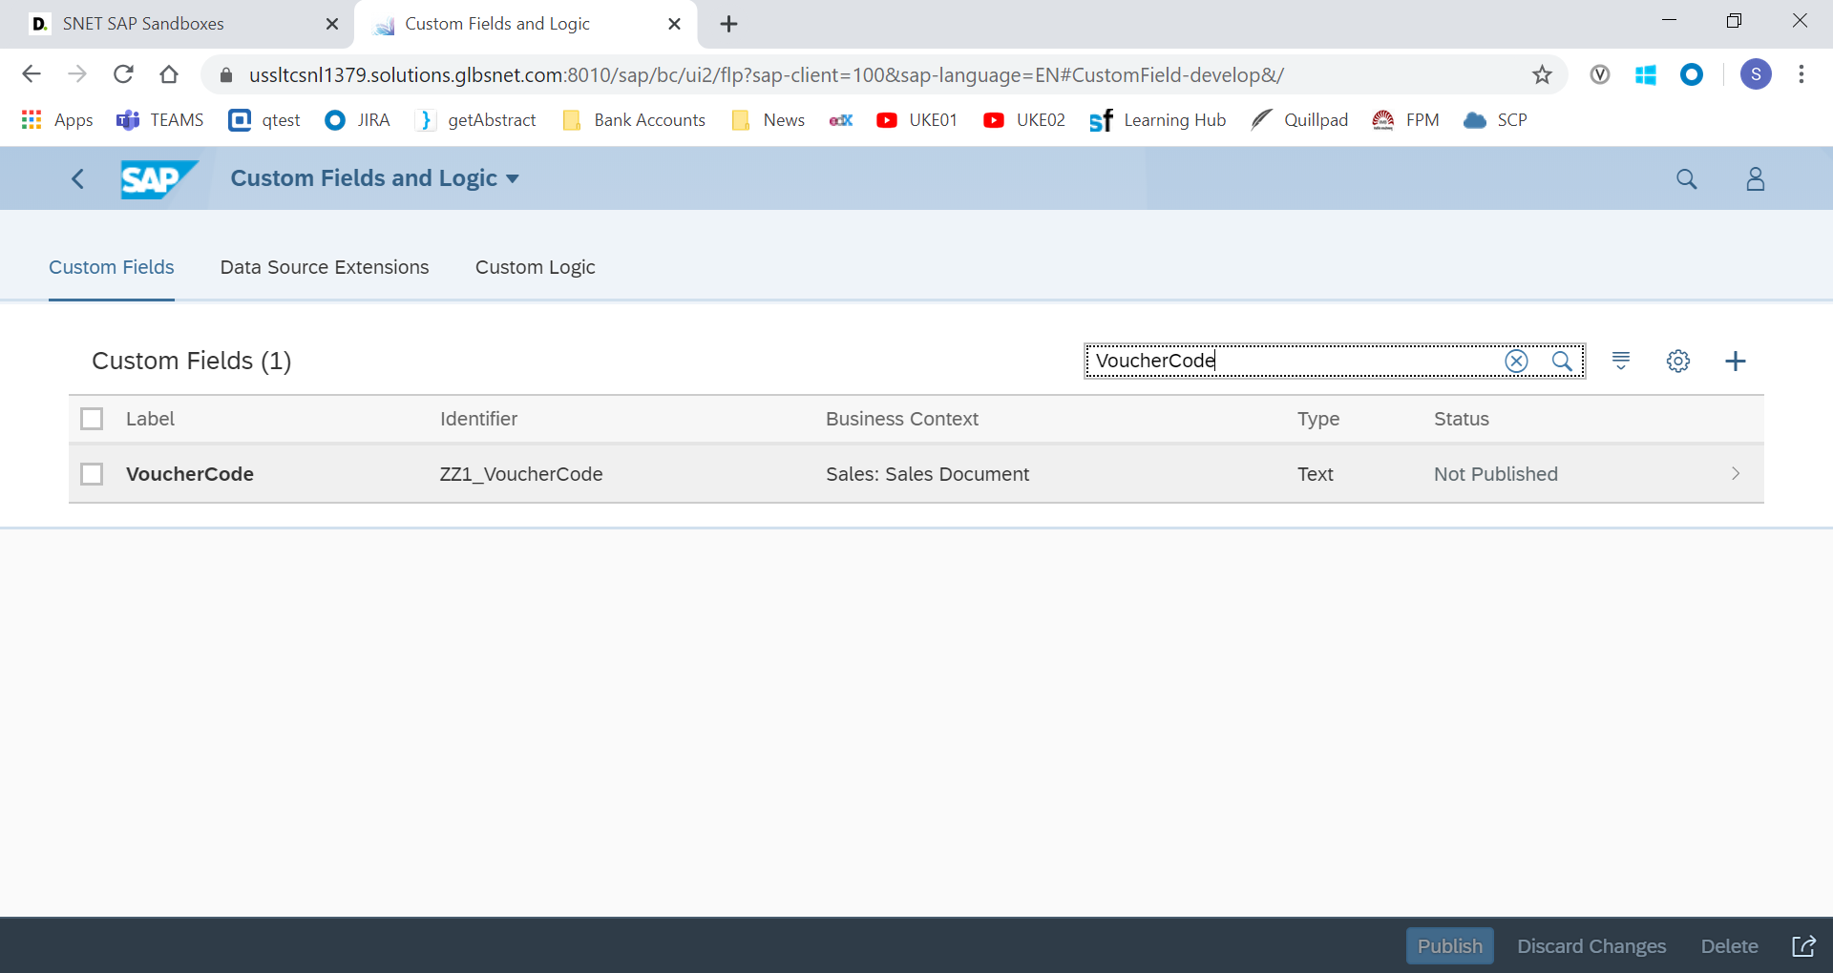

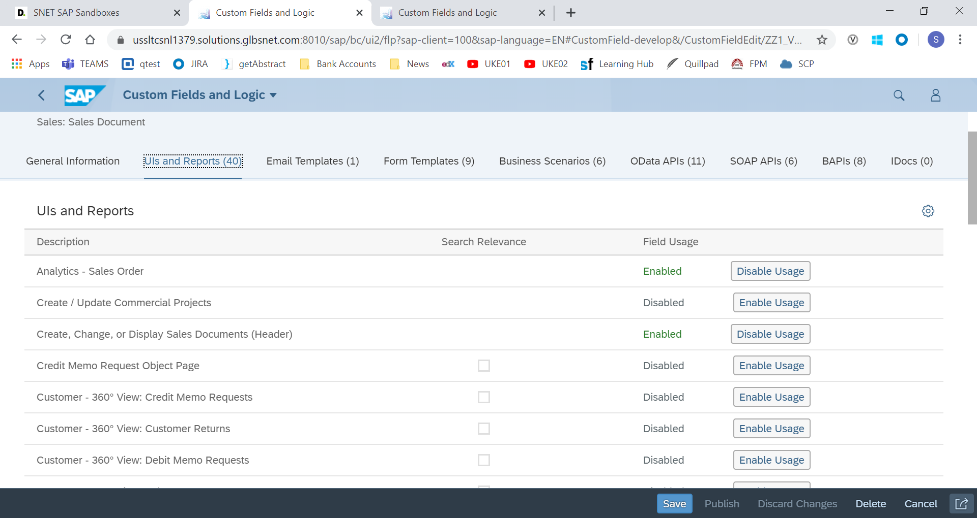
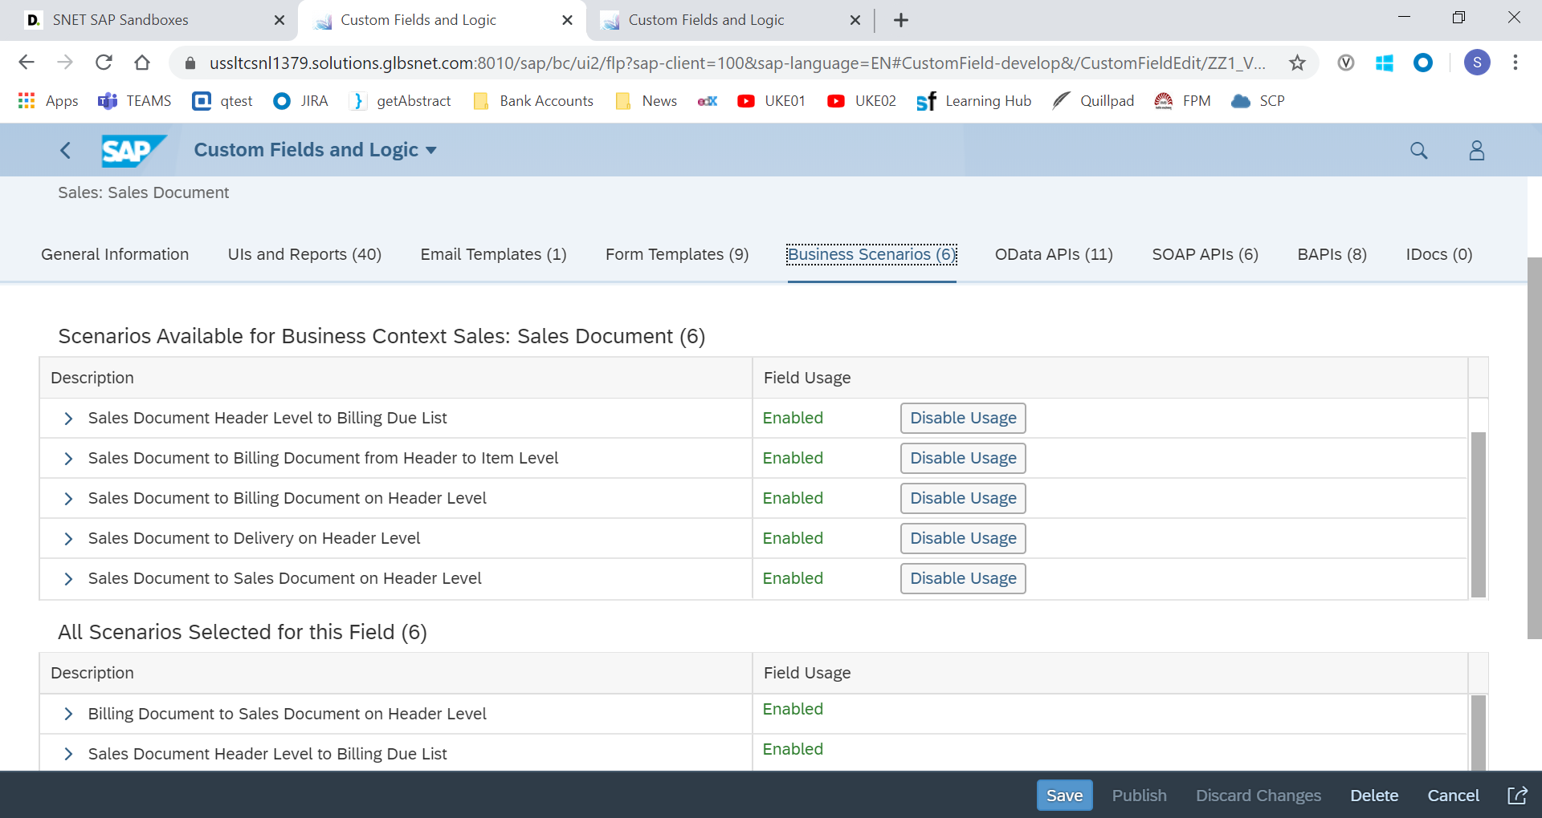
Illustration – Custom Fields

Slide 21
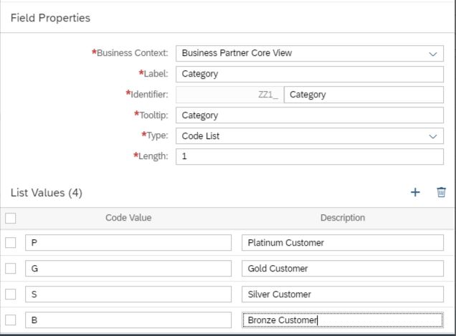
Fixed Values in Custom Field – Custom Field and Logic app

Slide 22
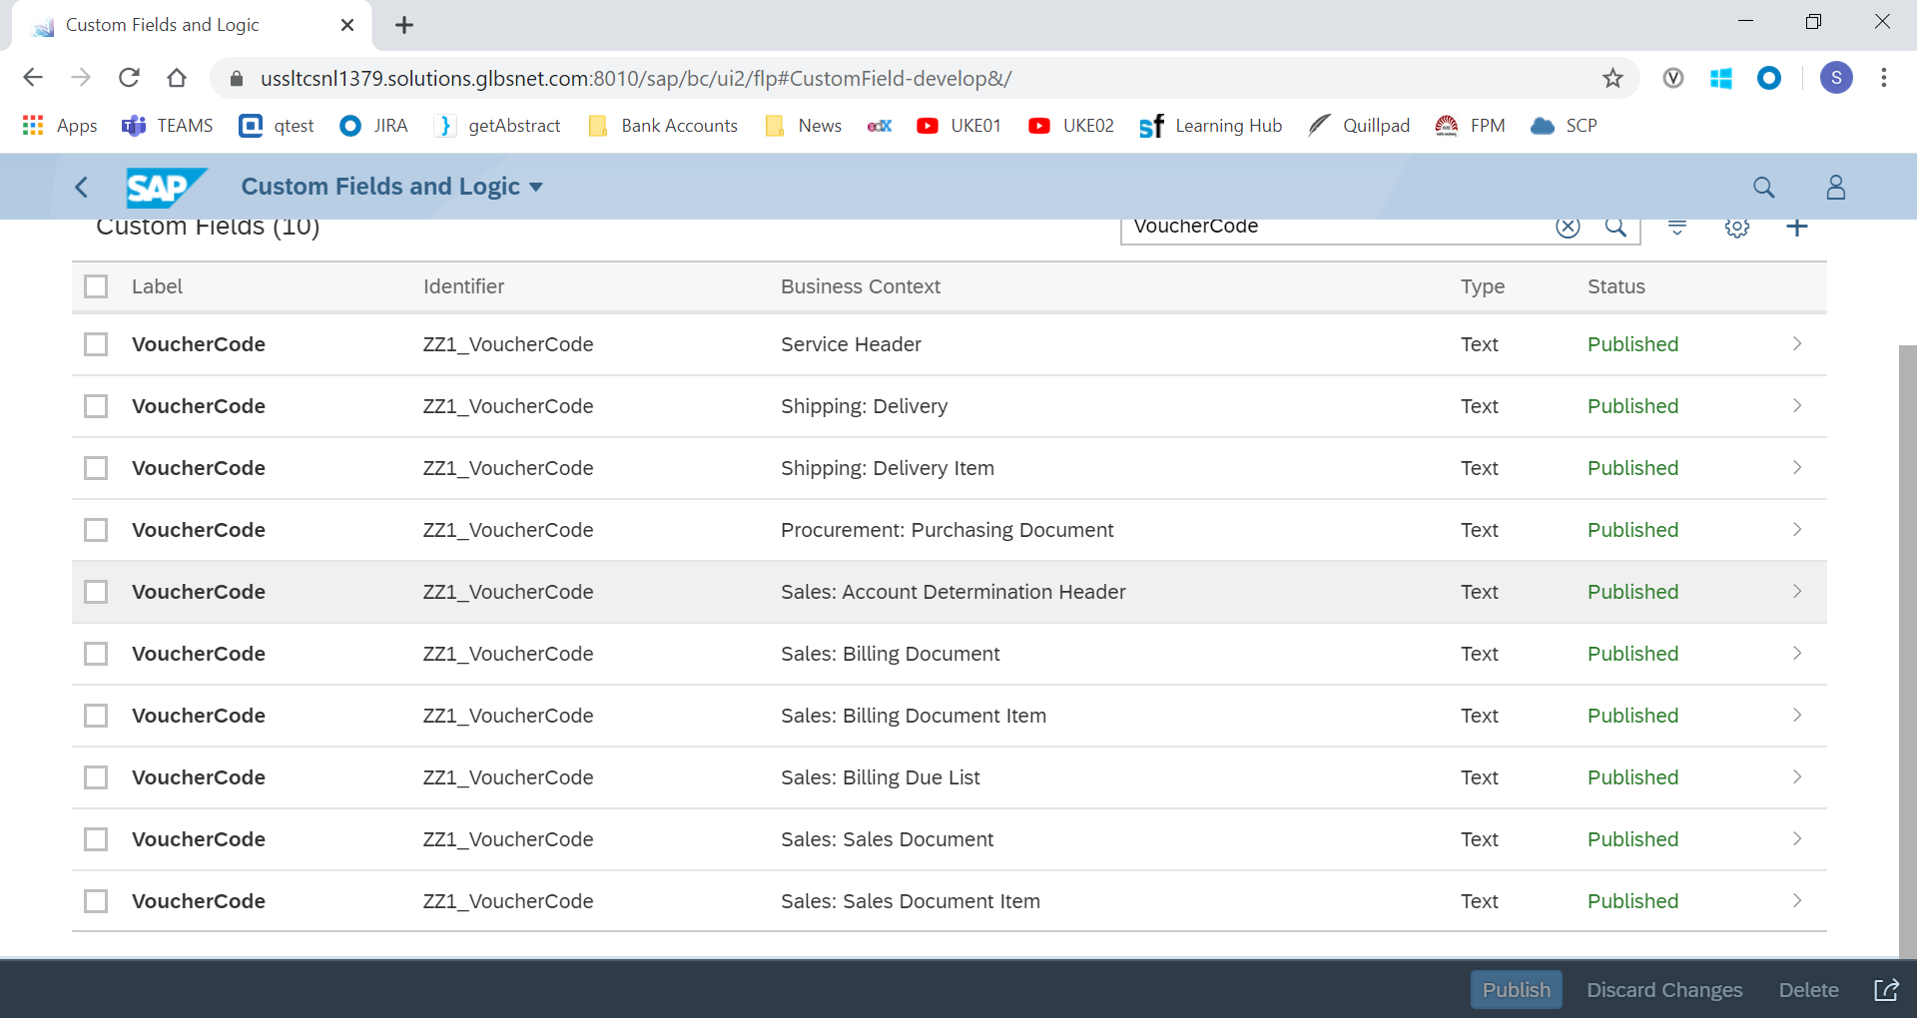
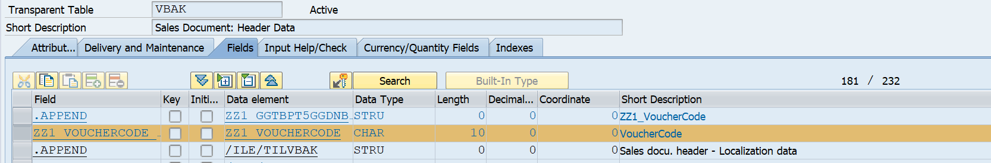
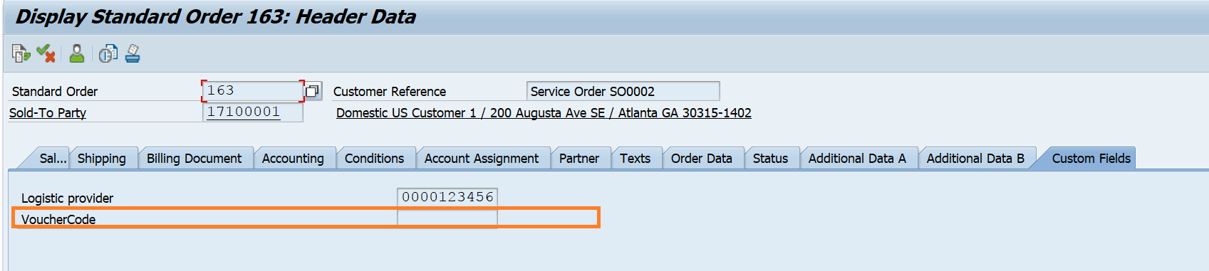
Illustration
Upon Publishing, added field would be updated in all relevant tables and screens.

Slide 23
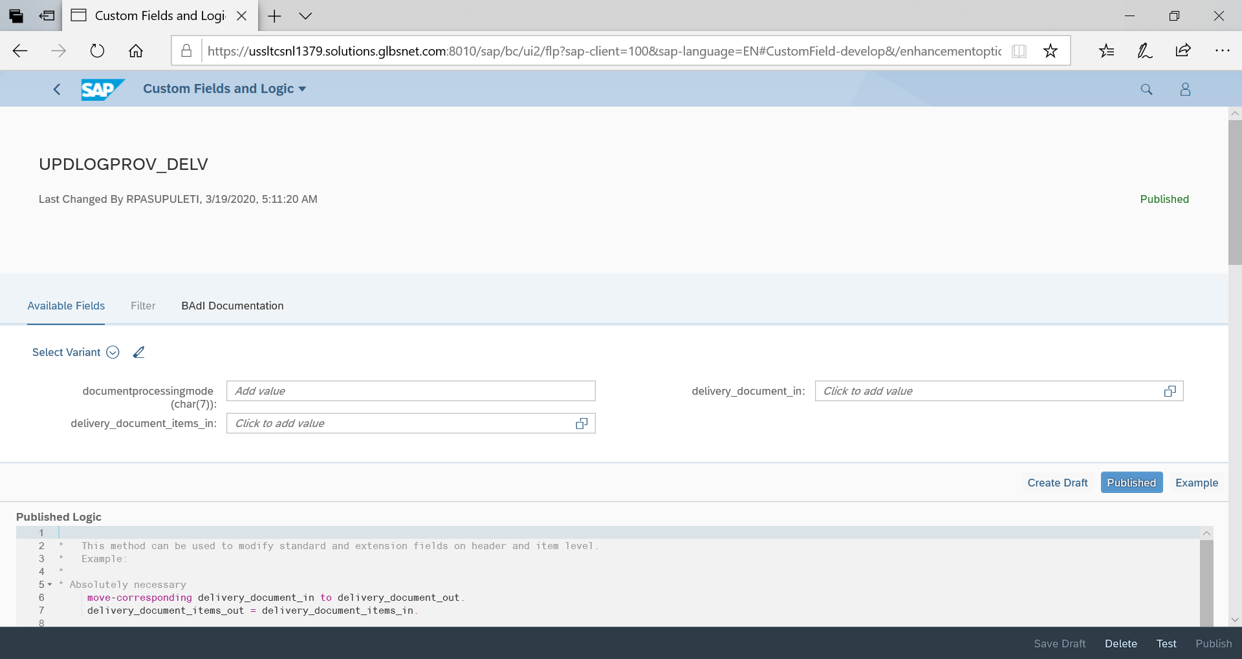
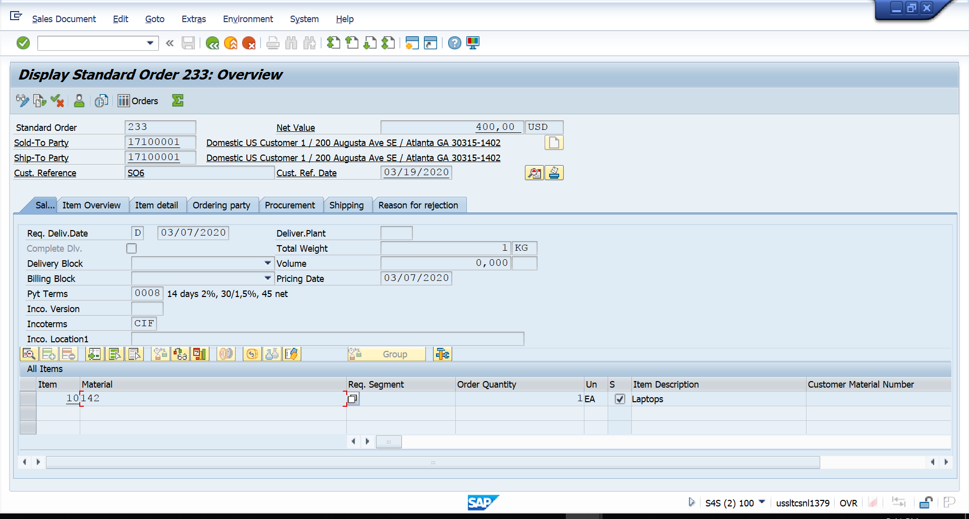
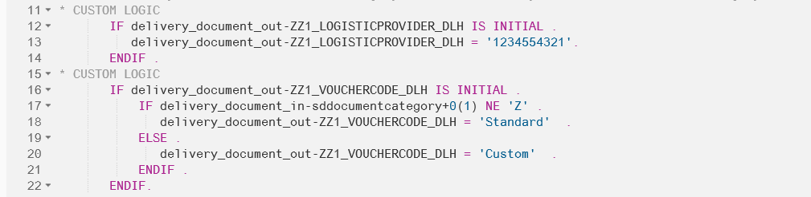
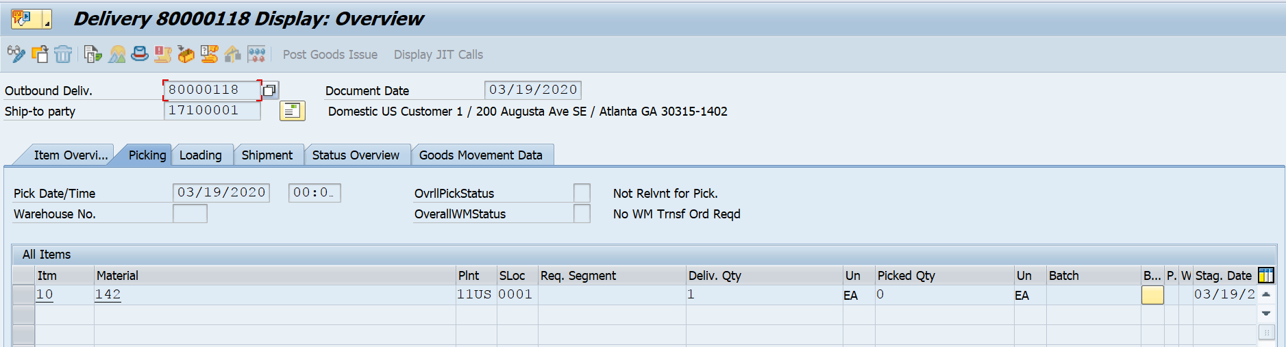
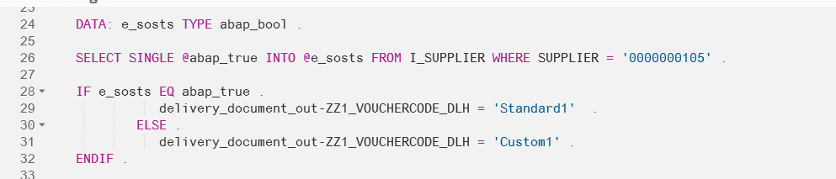
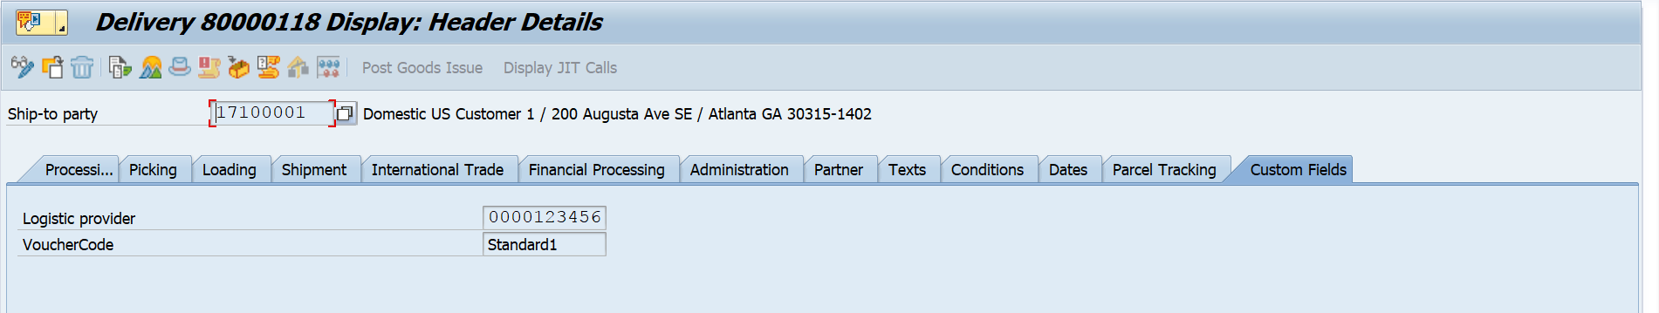
Illustration – Custom Logic
Demo

Slide 24
Custom CDS Views
Introduction
Displays list of all pre-existing CDS views including custom CDS views.
Allows user to create Custom CDS views using a primary data source and associated data sources if needed
Allows model the data access without amending underlying database tables; hence creating a degree of separation.
Custom CDS view can be consumed by UI, Analytics or any other system.
Key Considerations
Business Catalog SAP_CORE_BC_EXT and SAP_CORE_BC_COM should be assigned to the user. Allows users to create associations between multiple database views demanding caution especially when custom CDS is built upon other custom CDS views. CDS views can be exposed as external API by selecting the relevant checkbox on the General tab. Query cannot be used as a primary or associated data source for the CDS view. Parameters can be used only if the underlying data source contains parameters Filters are used to adjust the result set of the CDS view. Fields from associated data source can be used if the cardinality is 1:1.

Slide 25
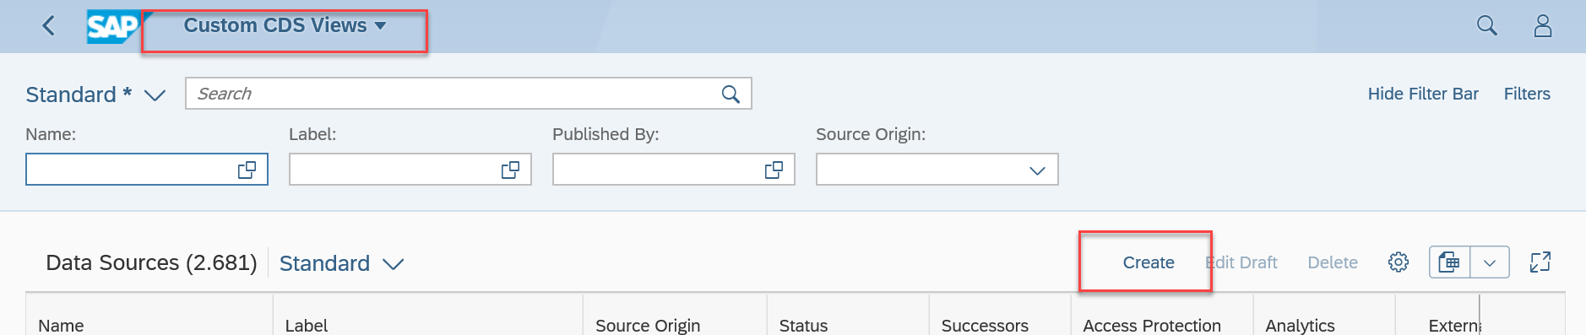
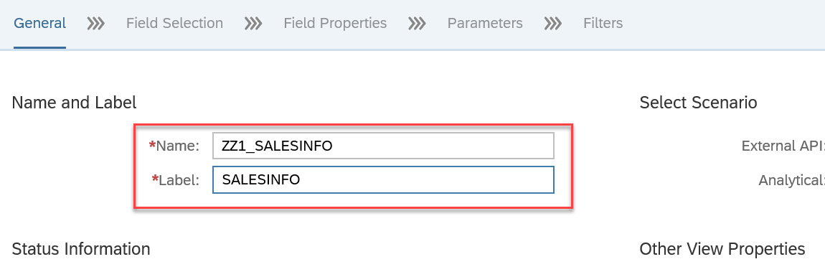
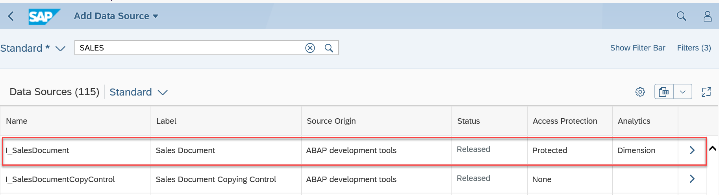
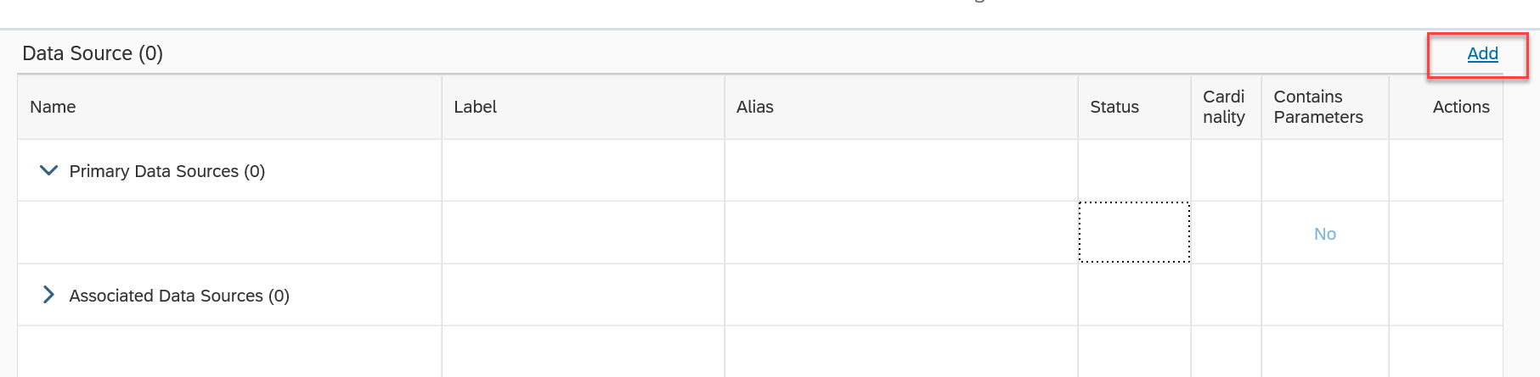
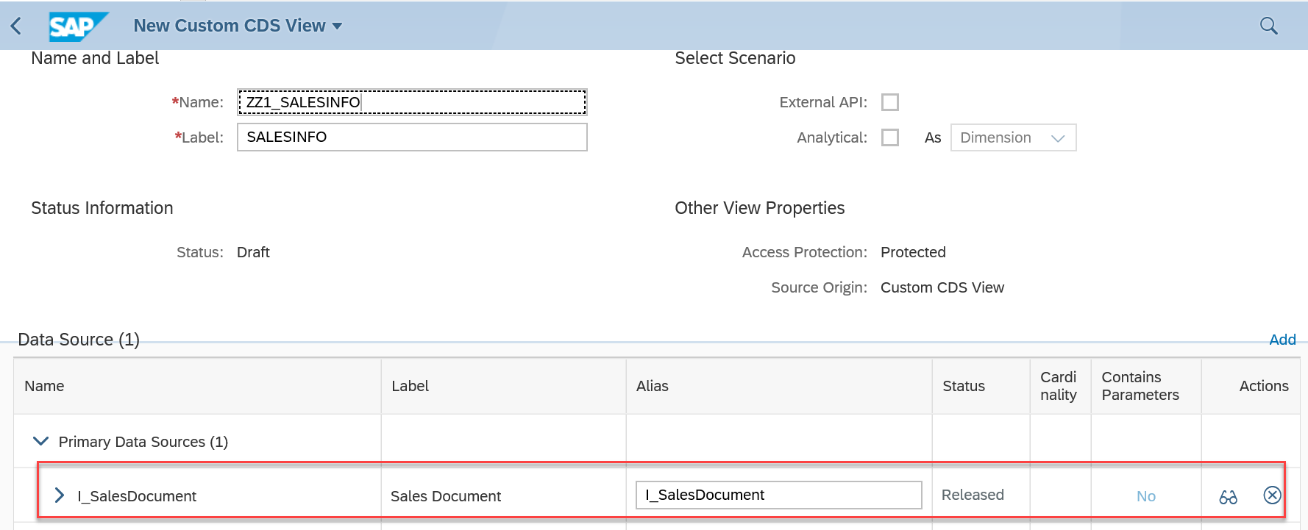
Illustration
Open Custom CDS View Application Create a new CDS View Add Data Source based on the requirement list of the available data sources

Slide 26
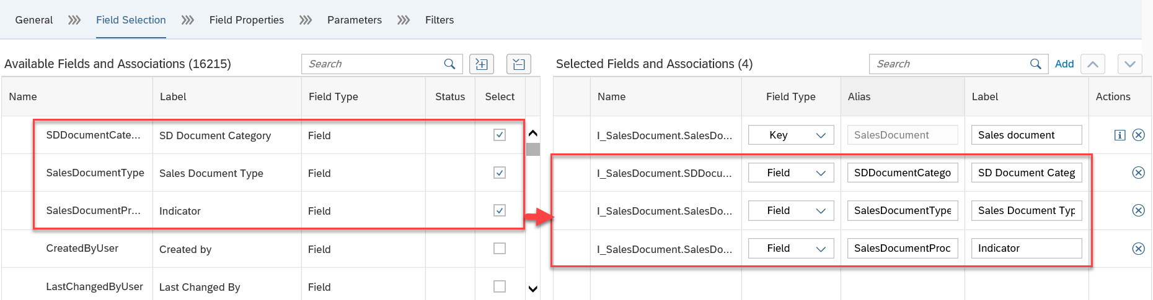
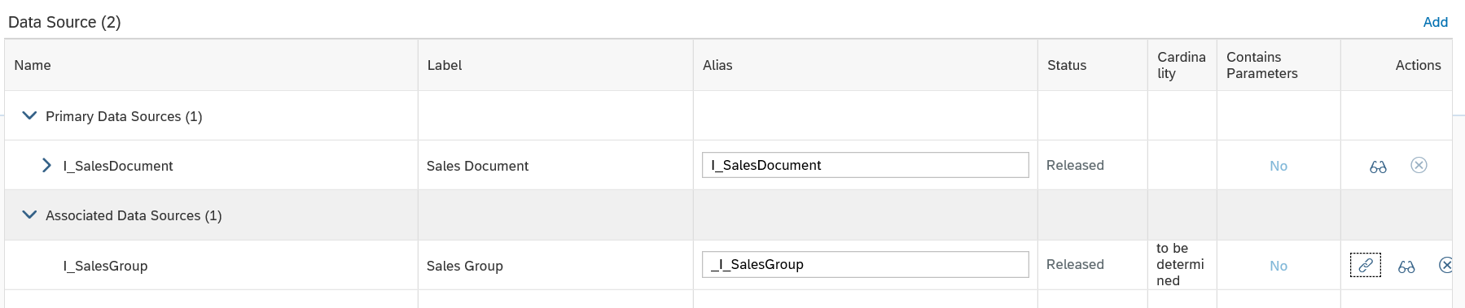
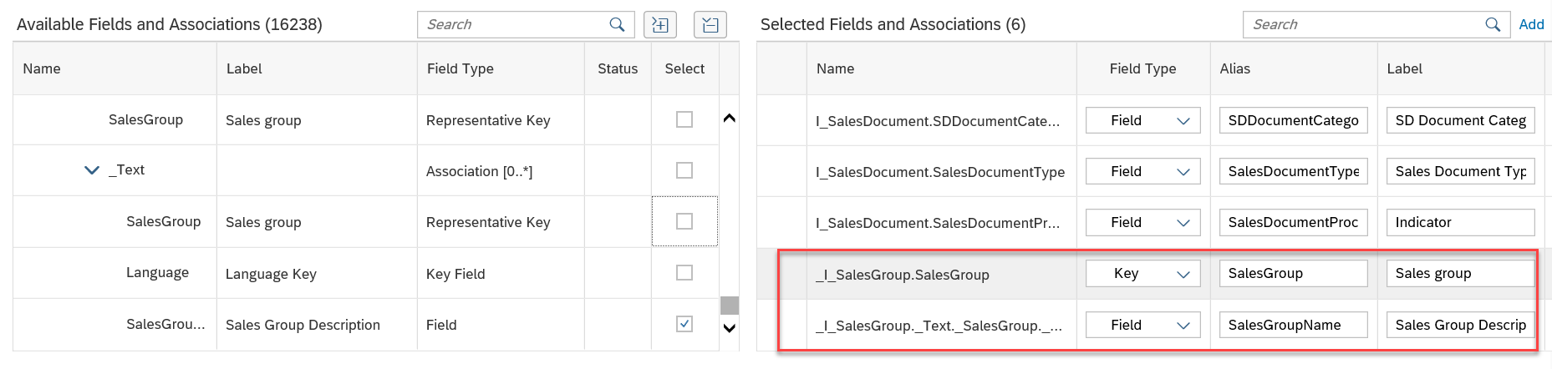
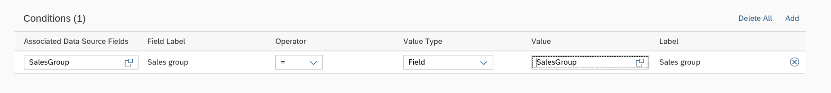
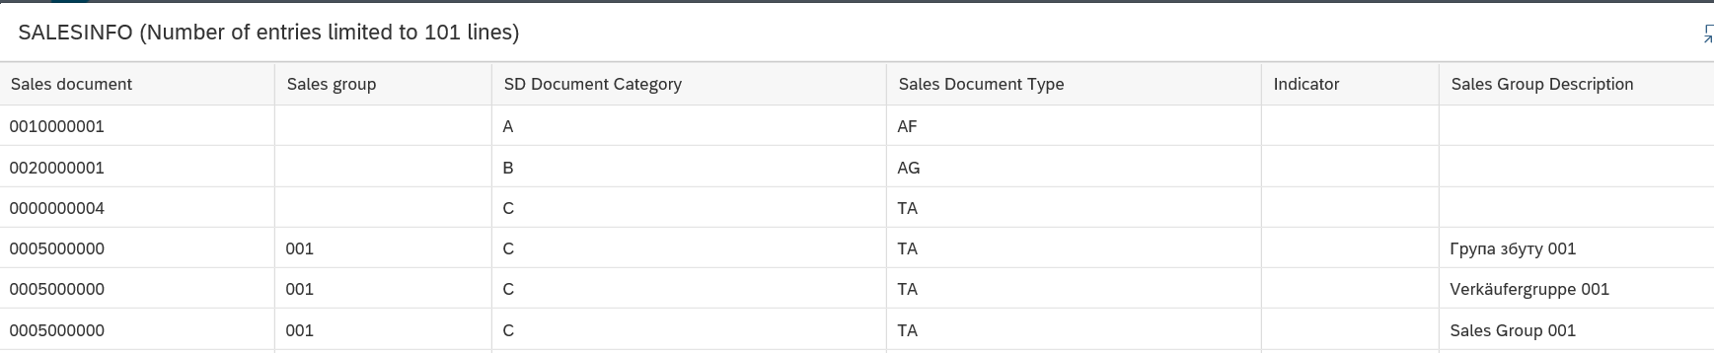
Illustration
Add fields based on the functional requirement apart from the Key field which is selected by default Associated Data Sources can be created as well

Slide 27
Analytical Queries
Introduction
Analytical Queries in CDS are used for reporting and analysis. Raw data from business documents are getting converted into a meaningful grid.
Analytical Queries can be created in CDS Views in a simple manner using the annotations.
We can analyze the Analytical queries using RSRT TCode directly without exposing the services to any of the reporting tools.
The Analytical Queries can be also exposed as Fiori tiles by exposing the Odata publish annotation.
Key Considerations
View becomes query view if annotation @Analytics.query: true is used, this annotation makes this view visible in query browser. Query view uses cube view created as data source. All the composite and base views should be active and appropriate roles should be given to access the analytical queries. @AnalyticsDetails.query.displayHierarchy: #ON is used for displaying the hierarchy @AnalyticsDetails.query.hierarchyInitialLevel: 10 is used for default expand level. @AnalyticsDetails.query.axis: #ROWS is used for defaulting attribute to row characteristics in query browser. @AnalyticsDetails.query.display: #KEY_TEXT is used for displaying text of the key @AnalyticsDetails.query.totals is used for displaying totals

Slide 28
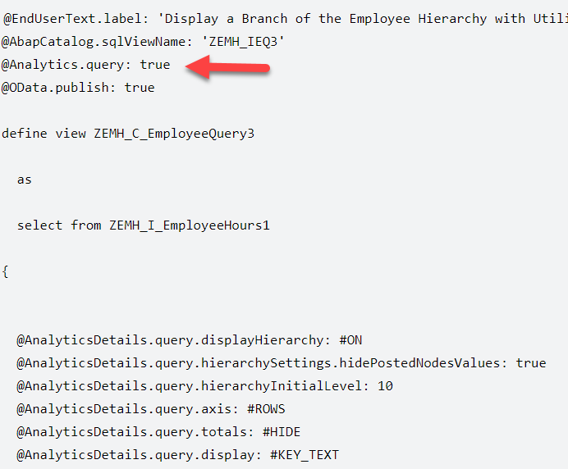
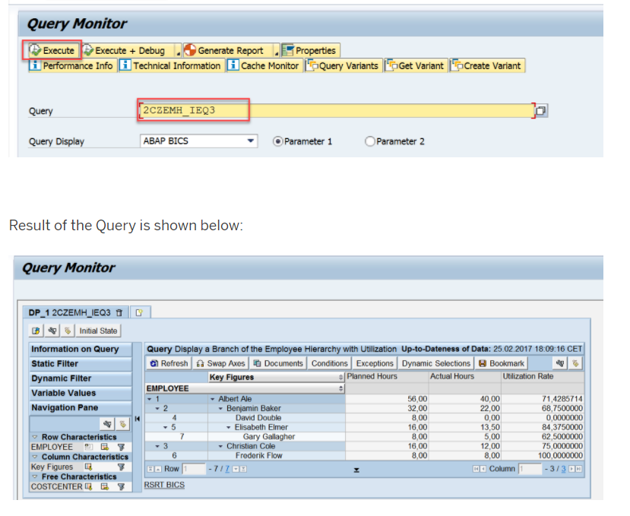
Illustration
Analytical Query Creation:
Testing the Analytical query:
Tcode RSRT is used for testing analytical query

Slide 29
Custom Business Objects
Introduction
Custom Business Objects: Custom Business Objects is a tool used to create your own business objects for use in database tables or as the basis for custom applications
Usage: The fields that you create for a custom business object can be used for database tables. You can also create OData services based on custom business objects.
Key Considerations
Create your own business objects and the corresponding database tables Generate OData services for custom business objects to work with and modify custom business objects from externally Publish business objects Edit business objects that have already been published Create multiple subnodes for one business object Create associations between custom business objects for reuse Implement custom logic on node level Reset business objects to their last published version Delete custom business objects and custom code lists that have not yet been transported to your production system

Slide 30
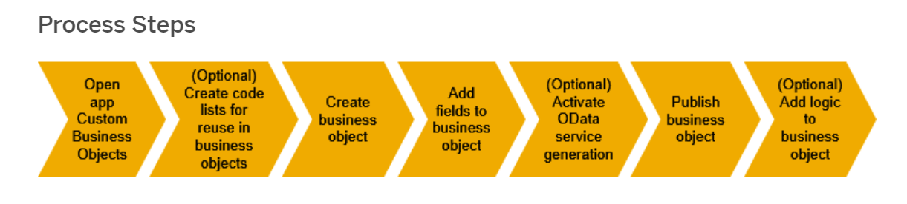
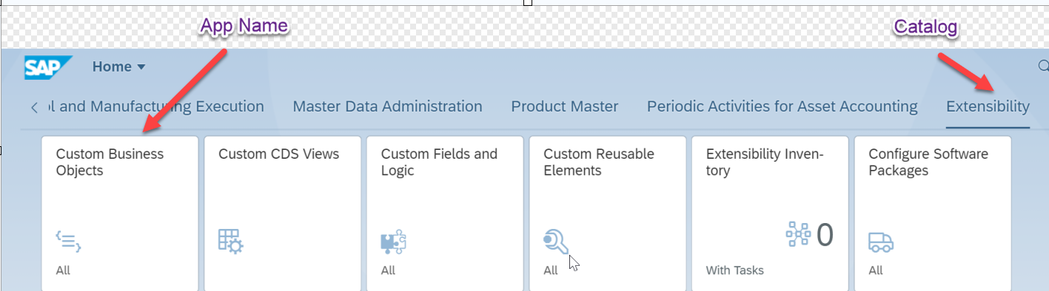
Select Extensibility Catalog and open Custom Business Object
Illustration

Slide 31
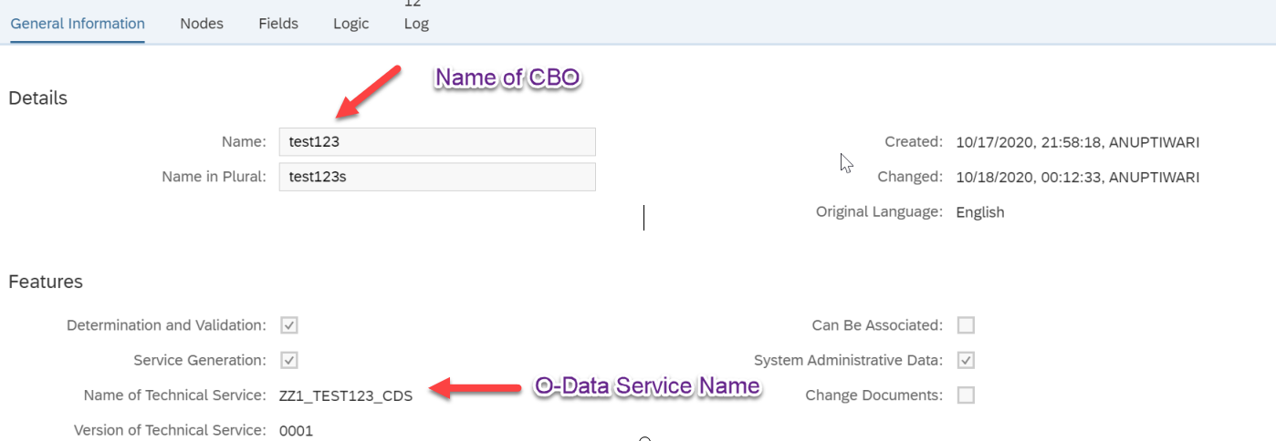
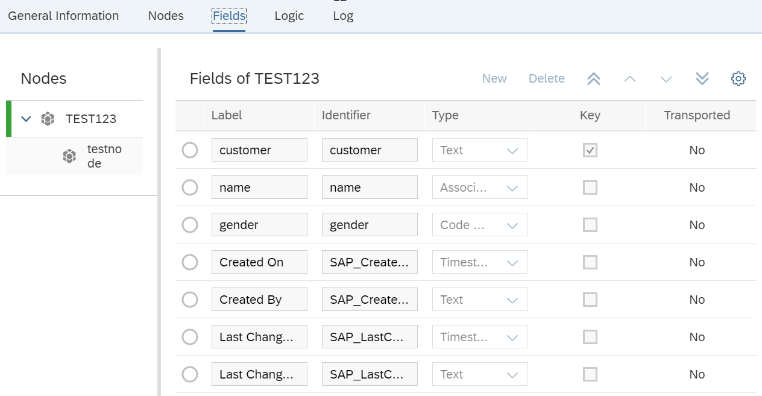
Enter Name (zz namespace) and select relevant check-box.
Illustration
Navigate to Fields tab and enter field name & datatype

Slide 32
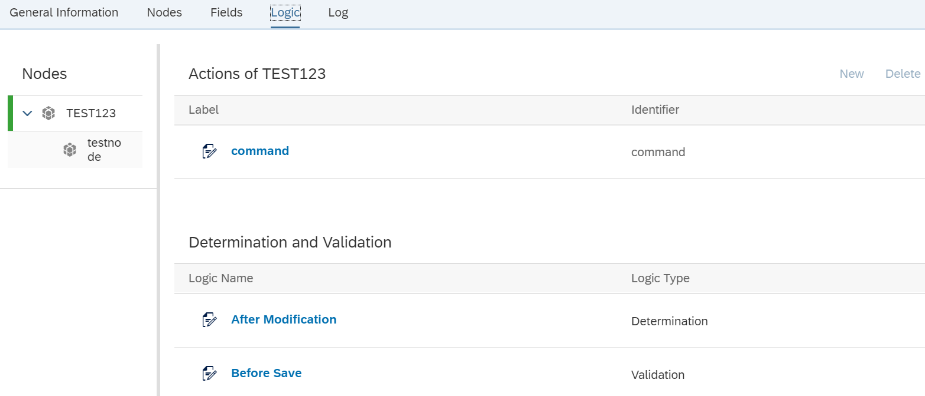
Illustration
Navigate to Logic tab and write custom logic based on the event.
Custom Logic can be added only after publishing the CBO.
Custom code scope is limited Restricted ABAP (whitelisted objects & custom object created from the extensibility catalog can only be referred )

Slide 33
Custom Forms
Introduction
Maintain form Templates app
SAP Pre-delivered from templates and translation
Odata service as data source (not ABAP interface)
Master form and Content form
New output management to be activated in SPRO
Custom Form:
Download Pre-delivered template, adjust it in ADLC and upload it back in ‘Maintain form templates’ app
Configure Master form and Content form in SPRO
Data source enhancement via ‘Custom Fields and Logic’ app
Custom fields added via ‘Custom Fields and Logic’ app
Key Considerations
Limited set of forms are pre-delivered Limited application object types support New output management (in STE edition) Additional fields added via ‘Custom Fields and Logic’ app will be added to database table If Data source extension is not possible, Odata service enhancement is suggested. Fall-back approach will be SFP based forms Traditional print frameworks are still supported

Slide 34
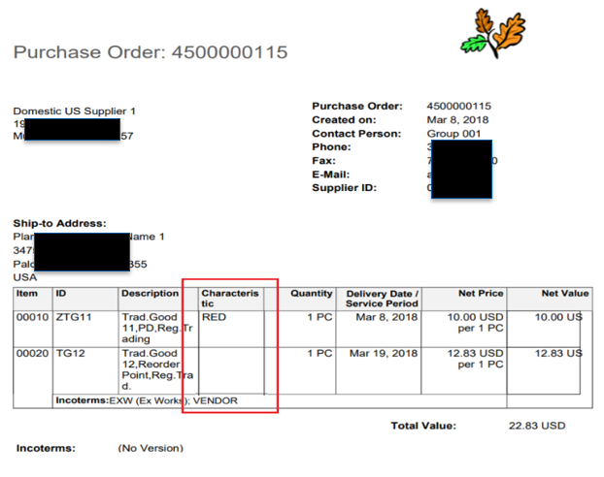
Illustration
Steps:
Add custom field in required business context using ‘Custom Fields and Logic’ app.
Enable the field in required Form.
Publish the changes to see the field in objects.
Download the standard template from ‘Maintain Form Templates’
Adjust the layout using Adobe Life Cycle designer.
Create a custom form template in ‘Maintain Form Templates’ app using the changed layout. Keep the data source as per the standard form template data source.
Configure the custom template in output management in SPRO.
App used:
Custom Fields and Logic
Maintain Form Templates

Slide 35
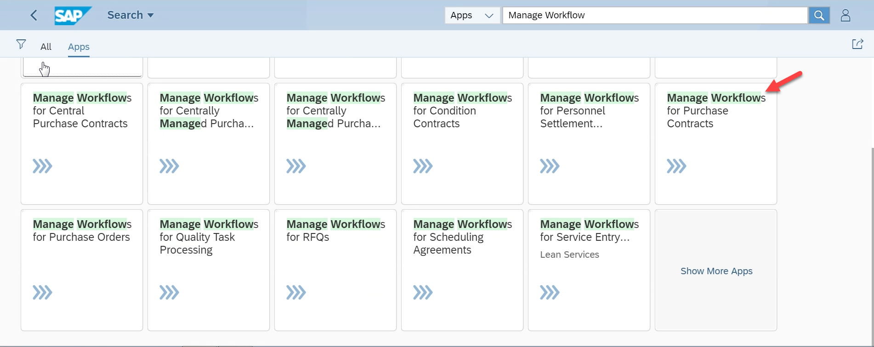
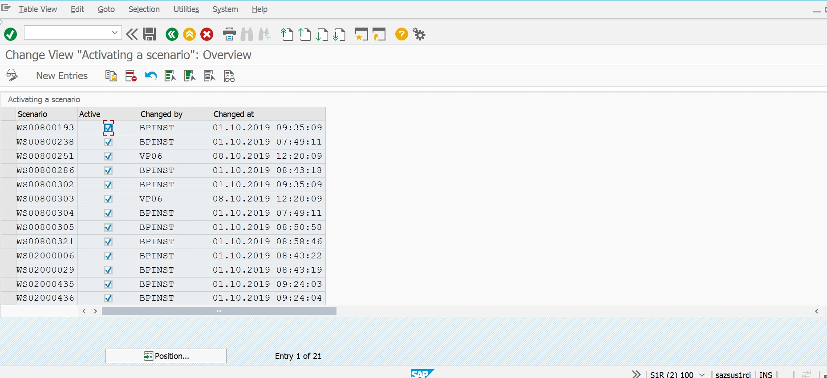
Illustration - Flexible Workflow ( In-app Extensibility )
Select the Manage Workflow for Purchase Contract (scenario)
If you are not able to see the Manage Workflow app, need to activate in the below Config with the scenario.

Slide 36
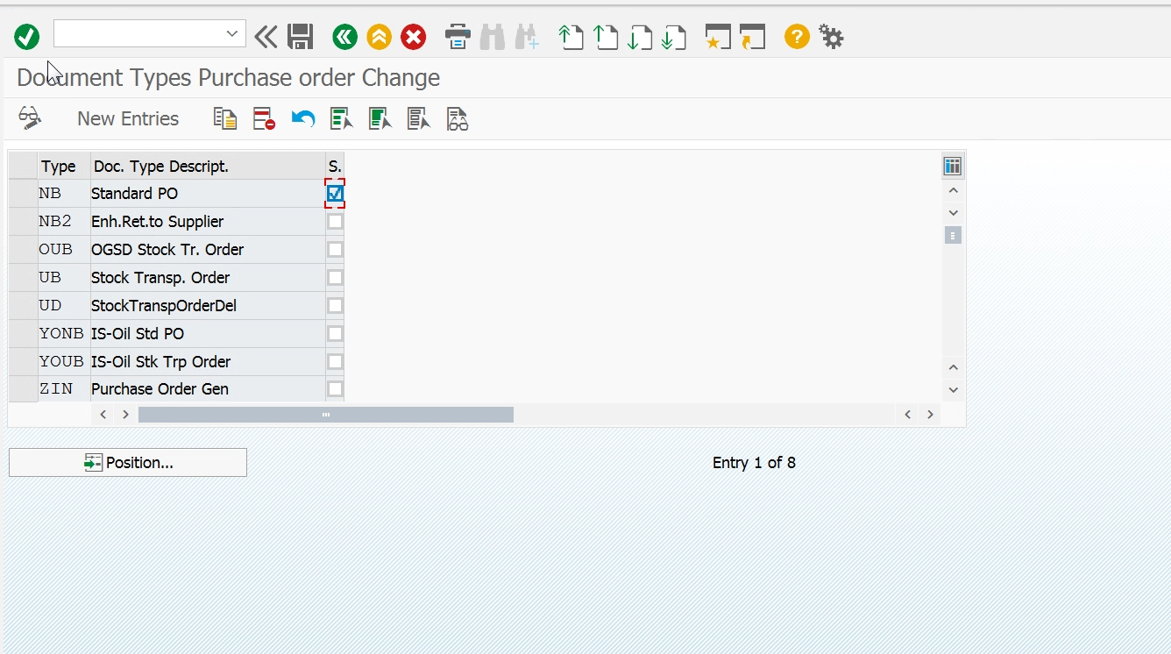
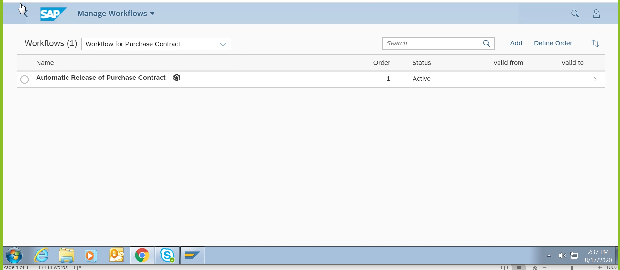
Illustration - Flexible Workflow
Once the app is activated, then we have to activate for which TYPE/ORDER/CONTRACT in the below config.
In SPRO – FLEXIBLE WORKFLOW based on the contract/types/order.
How to create flexible workflow
Now the Purchase order NB will be activated for flexible workflow. Like wise we can activate based on the requirement. Now create the PO in S/4 BOX and there will be an additional tab visible knows as Flexible Workflow.

Slide 37


Illustration - Flexible Workflow ( In app Extensibility )
We can add conditions in the below section

Slide 38



Illustration - Flexible Workflow
Agent assignment : 1. Role - BADI
Or 2. Role – different roles apart from BADI
Or 3. USER – user based

Slide 39


Illustration - Flexible Workflow
Exceptional handling if we want to add.
Activate the Workflow

Slide 40


Illustration - Flexible Workflow
Once it is activated , we can create the PO for the type NB. The work item will automatically float to my inbox app.
Check PO

Slide 41

Lifecycle Management

Slide 42


Slide 43
Side By Side Extensibility

Slide 44

Introduction
Empowers the user to integrate external content with SAP system seamlessly through APIs, services, applications, events etc.
By innovating Side-by-side extensibility, SAP provided greater and more open platform to work with other development environments like Java, Node.js, Python etc.
Available and compliant with innovative cloud services and solutions on SAP BTP like Machine Learning, Internet of Things, DataHub etc.
Unlike In-App Extensibility, Side-by-side Extensibility needs more technical knowledge from the developer

Slide 45

Side by Side Extensibility : Use case Diagram

Slide 46
In-App vs Side-by-side Extensibility
In-App Extensions are implemented in the SAP S/4 HANA core and there is no remote connection needed to access the extension from the extended app. In Side-by-side extensions, SAP BTP acts as a PaaS where extension apps might be on other platforms or SAP applications having a connection with the BTP.
In-App Extensions resides on SAP S/4 HANA Core and hence is compatible with SAP technologies only like SAP ABAP, CDS etc. On the other hand, SAP BTP can leverage open-source technologies, the Side-by-side extensions has other compliant technologies in the scope which are not developed by SAP like Java or Node.JS.

Slide 47
About Deloitte Deloitte refers to one or more of Deloitte Touche Tohmatsu Limited, a UK private company limited by guarantee (“DTTL”), its network of member firms, and their related entities. DTTL and each of its member firms are legally separate and independent entities. DTTL (also referred to as “Deloitte Global”) does not provide services to clients. In the United States, Deloitte refers to one or more of the US member firms of DTTL, their related entities that operate using the “Deloitte” name in the United States and their respective affiliates. Certain services may not be available to attest clients under the rules and regulations of public accounting. Please see www.deloitte.com/about to learn more about our global network of member firms.
Copyright © 2019 Deloitte Development LLC. All rights reserved.

Slide 48
Further Reading
https://extensibilityexplorer.cfapps.eu10.hana.ondemand.com/ExtensibilityExplorer/
https://www.sap.com/documents/2018/05/606d1ee8-037d-0010-87a3-c30de2ffd8ff.html
https://blogs.sap.com/2020/03/05/s-4hana-in-app-extensibility-end-of-classical-extensions/
https://blogs.sap.com/2019/03/20/extending-customer-master-app-in-app-extensibility/
http://www.sapspot.com/s-4hana-in-app-extensibility-end-of-classical-extensions/
https://blogs.sap.com/2018/02/09/sap-s4hana-cloud-side-by-side-extensibility/
TechEd 2020: Extensibility for SAP S/4HANA: The Big Picture [DT113]
https://developers.sap.com/group.abap-extensibiliy-cbo-cce-ccl.html
https://blogs.sap.com/2019/07/25/sap-s4hana-extensibility-a-learning-journey/

